Slide 1
Coheire

Slide 2
Intro
What is Coheire?
A job opportunity platform like indeed.com/glassdoor.com.
What does Coheire do?
Connect between the companies seek for programmers and the programmers seek for the job.
Why Coheire?
Coheire has a focused target market that is easier to attract talents/companies in the specific area.

Slide 3
Design
Functional Design
Applicant can look for different types of positions (Done) based on different locations
Employer can post jobs and receive applications. (Done)
Provide microservices for both applicants and employers, like online certification, personal showcase, company review, etc. (In the future)
UI/UX Design (In the future)
Use programming style elements in terms of font-style, wording, layout, etc.

Slide 4
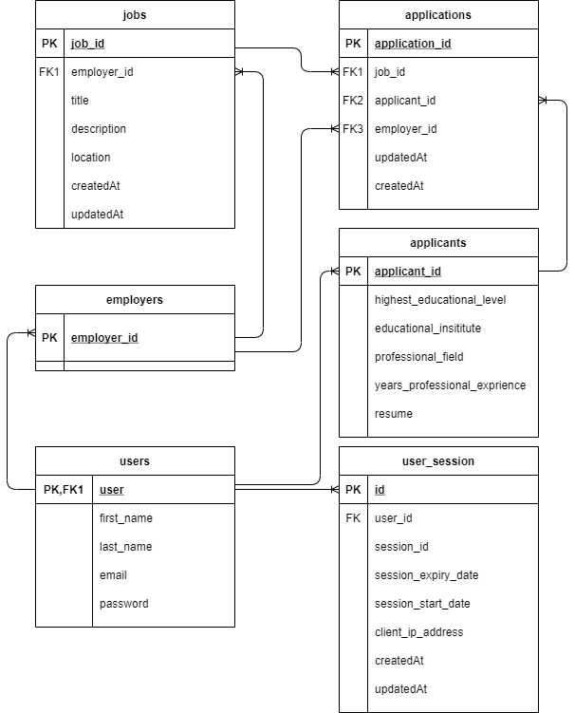
Database Design

Slide 5
Implementation
Technology used in Web Development
Back-end
NodeJS, Express, MySQL, Bcrypt, Sequelize, Multer
Front-end
Angular, Bootstrap 5, file-saver

Slide 6
Challenges
Database Design
Session token generation and tracking
File upload and download

Slide 7
Marketing
Advantage
Precise target market
Attractive and familiar layout to applicant (programmer)
Microservices that help both employers and applicant in the process

Slide 8
Thank you

